Slide 1
Grading Algorithm Performance

Slide 2
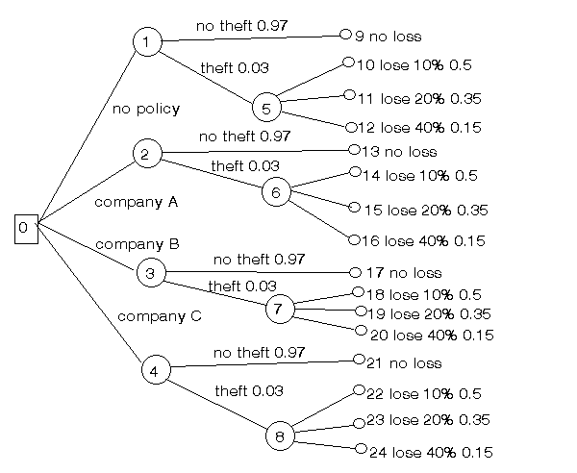
Theft Insurance Plans
Householder considering insurance policies
Prices for insurance policies will be stored as data at Decision Nodes
Compare and contrast different plans

Slide 3
Perfect Tree Comparison
ruby test_perfect_theft_tree.rb
The grade of the exact copy for the presence check step for nodes is: 100.0
Not found count: 0.0 Depth difference : 0 Average depth difference: 0.0
The grade of the exact copy for the similarity comparison check step is: 100.0
The grade of the exact copy for the presence check step for edges is: 100.0
The overall grade for the student tree is: 100.0
Expected performance is matched, the perfect match is given a 100% grade

Slide 4
Above Average Tree Comparison
ruby test_above_average_theft_tree.rb
The grade of the above average copy for the presence check step for nodes is: 68.0
Not found count: 0.0 Depth difference : 0 Average depth difference: 0.0
The grade of the above average copy for the similarity comparison check step is: 100.0
The grade of the above average copy for the presence check step for edges is: 66.66666666666666
The overall grade for the student tree is: 77.13333333333333
Average expected performance

Slide 5

Half Tree Comparison
ruby test_half_theft_tree.rb
The grade of the half copy for the presence check step for nodes is: 36.0
Not found count: 0.0 Depth difference : 0 Average depth difference: 0.0
The grade of the half copy for the similarity comparison check step is: 100.0
The grade of the half copy for the presence check step for edges is: 33.33333333333333
The overall grade for the student tree is: 54.26666666666666
Average expected performance

Slide 6
Empty Tree Comparison
ruby test_empty_theft_tree.rb
The grade of the empty tree for the presence check step for nodes is: 0.0
The grade of the empty tree for the similarity comparison check step is: 0
The grade of the empty tree for the presence check step for edges is: 0.0
The overall grade for the student tree is: 0.0
Submission of nothing or one non-matching node yields 0 points

Slide 7
Tree with Extra Nodes Comparison
ruby test_extra_theft_tree.rb
The grade of the extra nodes copy for the presence check step for nodes is: 100.
Not found count: 2.0 Depth difference : 0 Average depth difference: 0.0
The grade of the extra nodes copy for the similarity comparison check step is: 92.0
The grade of the extra nodes copy for the presence check step for edges is: 100.0
The overall grade for the student tree is: 97.6
Two extra nodes but otherwise rest of tree matching
Won’t hurt student as much as long as major requirements met
More extra nodes would yield lower score

